Slide 1

Rahul Srivastava

Slide 2
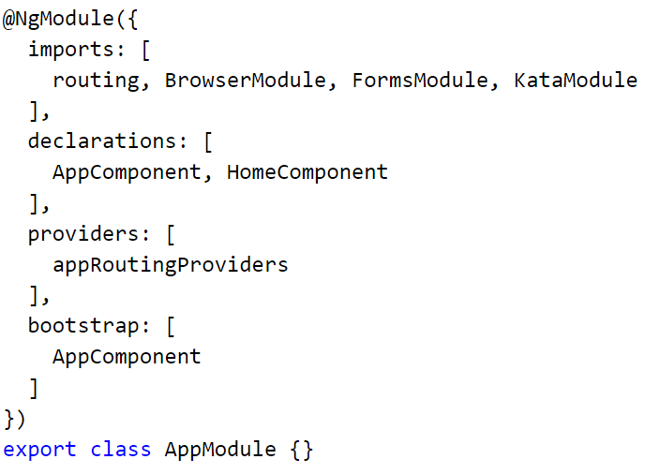
Modules
Notes:
Angular 2’s organizational unit
Contains services, directives, pipes and

Slide 3
Contrived example
Accounting
Accounts Payable
Accounts Receivable
Payroll
Customers
Sales
Account management
Support
IT
Systems support
Development

Slide 4
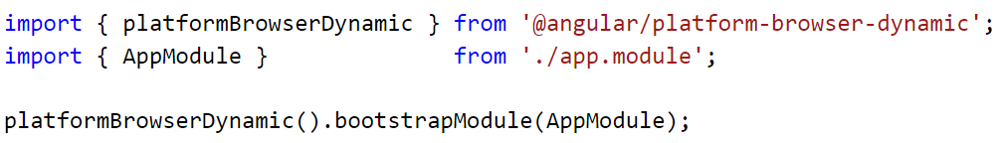
Running your app
Import your root NgModule
Bootstrap it!

Slide 5
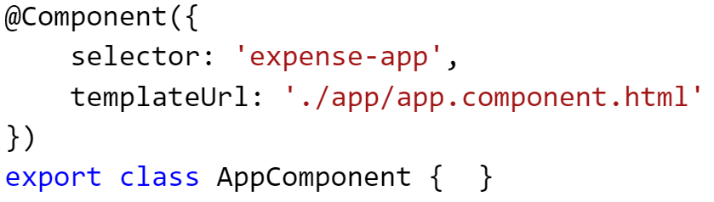
Components

Slide 6
Declaring a component
Create your class
Import the Component decorator
Add a template and a selector

Slide 7
Templates in your component
@Component({
selector: 'my-app',
template: '<h1>This is some HTML</h1>'
})
export class AppComponent {}

Slide 8
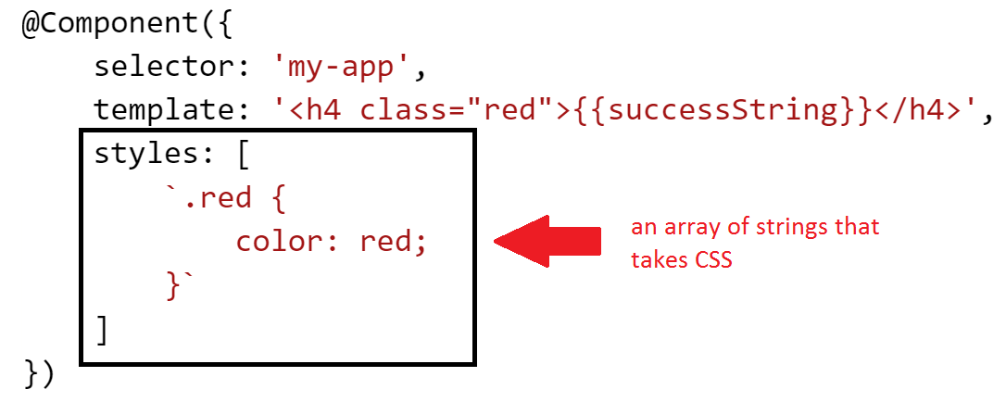
Styling a component
You can add CSS directly to a component! Demo

Slide 9

Components
Favor many smaller components over fewer bigger ones.

Slide 10
Binding component to template
Interpolation expressions
Property binding
Event binding
ngModel

Slide 11
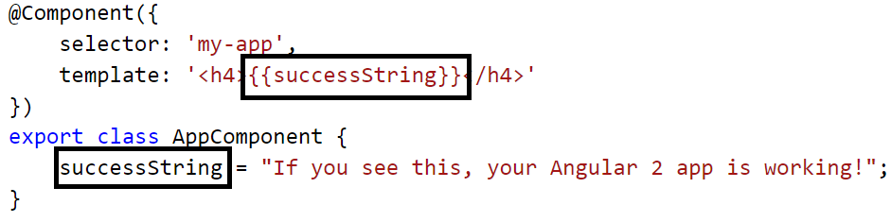
Interpolated expressions

Slide 12
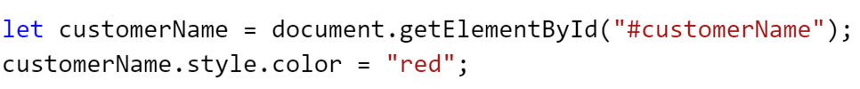
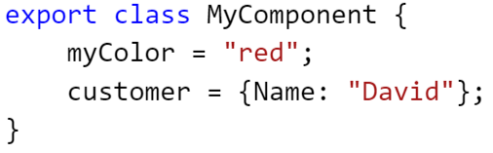
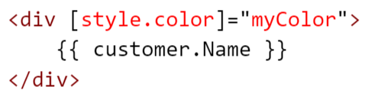
Property binding

Slide 13
Property binding
Property binding means that all sorts of previous built-in directives in Angular 1 go away
Ng1 Directive | Functionality | Replaced with
ng-disabled | Disables the control – used on inputs, selects, textareas | [disabled]=“expression”
ng-src/ng-href | Replacement for src/href properties since interpolation didn’t play well with them | [src]=“expression” [href]=“expression”
ng-show/ng-hidden | Hides/shows an element based on the truthiness of an expression | [hidden]=“expression”

Slide 14
Binding component to template
Interpolation expressions
Property binding
Event binding
ngModel

Slide 15
Interpolated expressions

Slide 16
Property binding

Slide 17
Property binding
Property binding means that all sorts of previous built-in directives in Angular 1 go away
Ng1 Directive | Functionality | Replaced with
ng-disabled | Disables the control – used on inputs, selects, textareas | [disabled]=“expression”
ng-src/ng-href | Replacement for src/href properties since interpolation didn’t play well with them | [src]=“expression” [href]=“expression”
ng-show/ng-hidden | Hides/shows an element based on the truthiness of an expression | [hidden]=“expression”

Slide 18
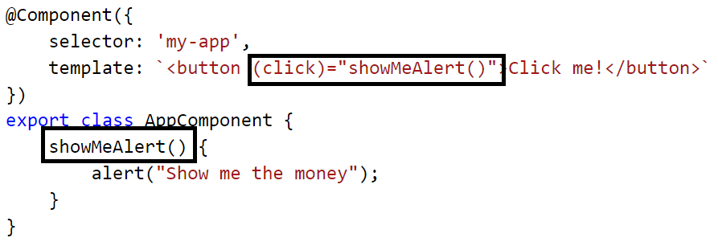
Event binding
Bind directly to events on the DOM model using ()

Slide 19
Event binding, cont’d
Property binding means that all sorts of previous built-in directives in Angular 1 go away
Ng1 directive | Functionality | Replaced with
ng-click | Binds an expression to the click event | (click)=“doSomething()”
ng-change | Binds an expression to the input changed event | (change)=“prop = $event” (ngModelChange)=“”
ng-dblclick | Binds an expression to the double click event | (dblclick)=“onDoubleClick()”
ng-mouseover | …mouse over event
ng-mousemove | …mouse move event
…you get the idea

Slide 20
ngModel
Allows two-way binding
Follows unidirectional data flow concepts
Demo

Slide 21
Child components
A child component is a component that exists within a component
I know, pretty crazy right?

Slide 22
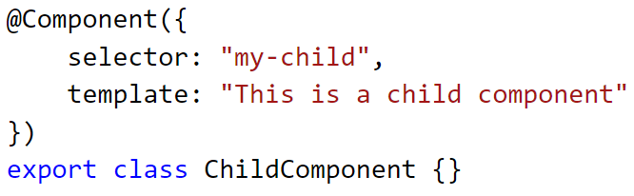
Step 1: Declare your component

Slide 23
Step 2: Import it to your containing module
import { ChildComponent } from "./child.component";
@NgModule({
declarations: [AppComponent]
})
export class AppModule {
}

Slide 24
Step 3: Register
import { ChildComponent } from "./child.component";
@NgModule({
declarations: [AppComponent, ChildComponent]
})
export class AppModule {
}

Slide 25
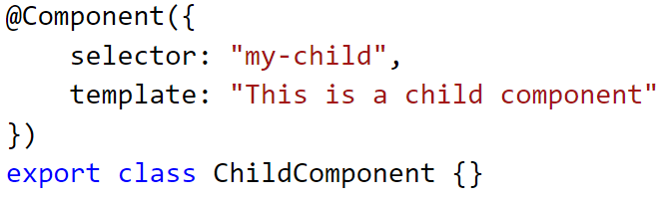
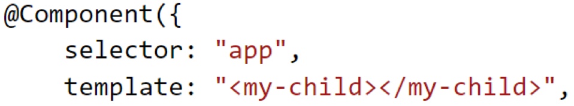
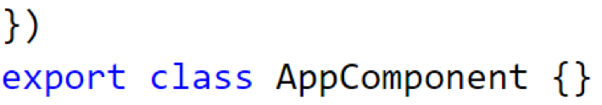
Step 4: Add child selector to markup

Slide 26
But how do components talk??
Inputs and Outputs

Slide 27
Let’s start with inputs

Slide 28
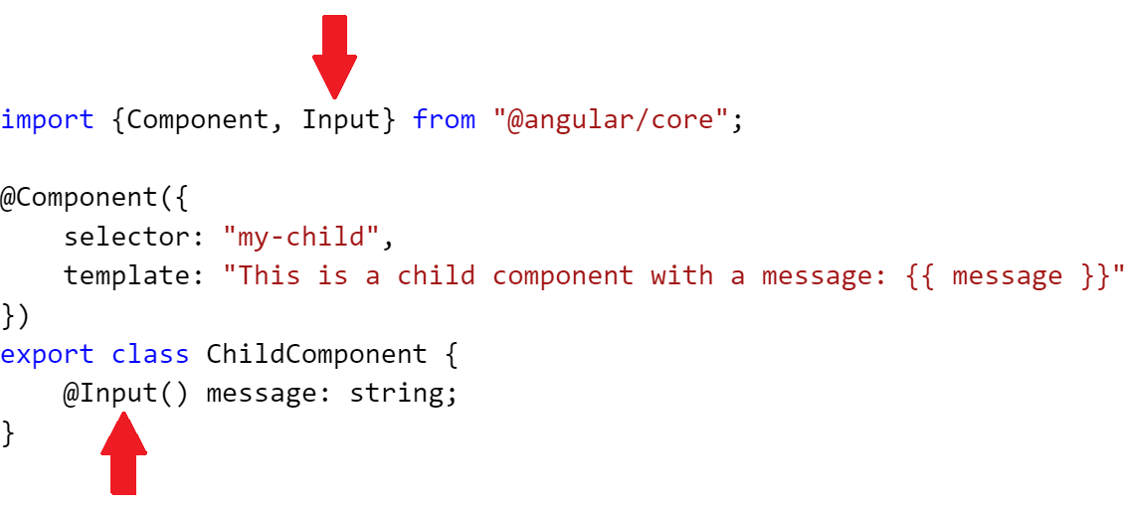
Step 1: Add the input property

Slide 29
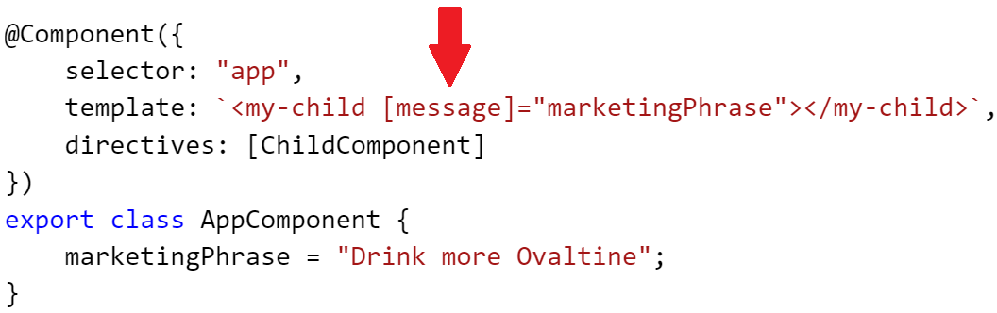
Step 2: Bind the parent property to that property

Slide 30
Now Outputs and EventEmitter

Slide 31
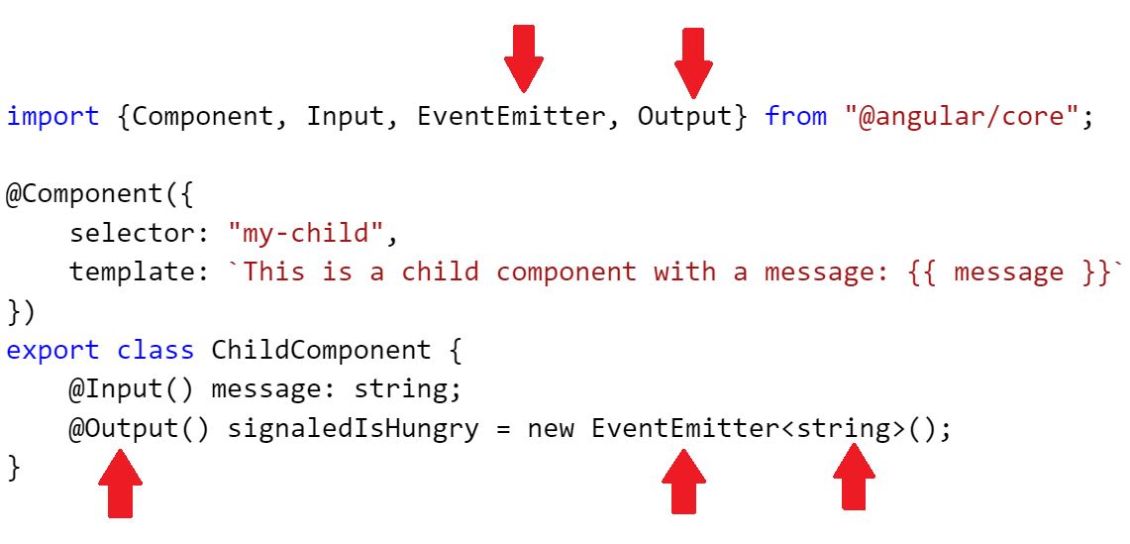
Import and implement

Slide 32
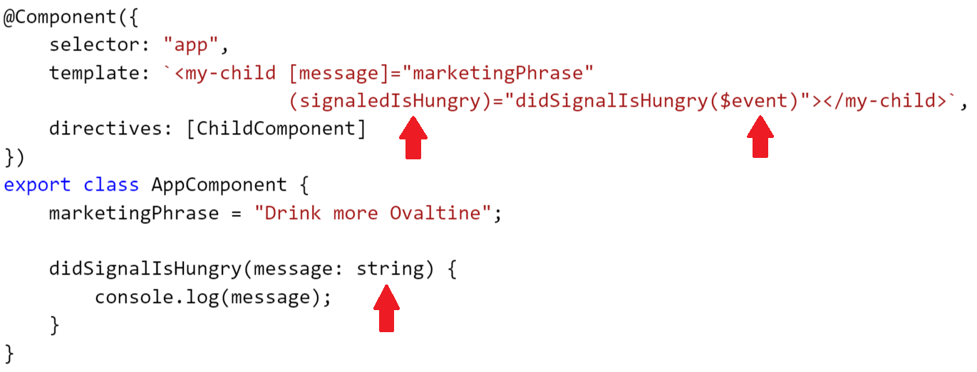
Add subscribing function

Slide 33
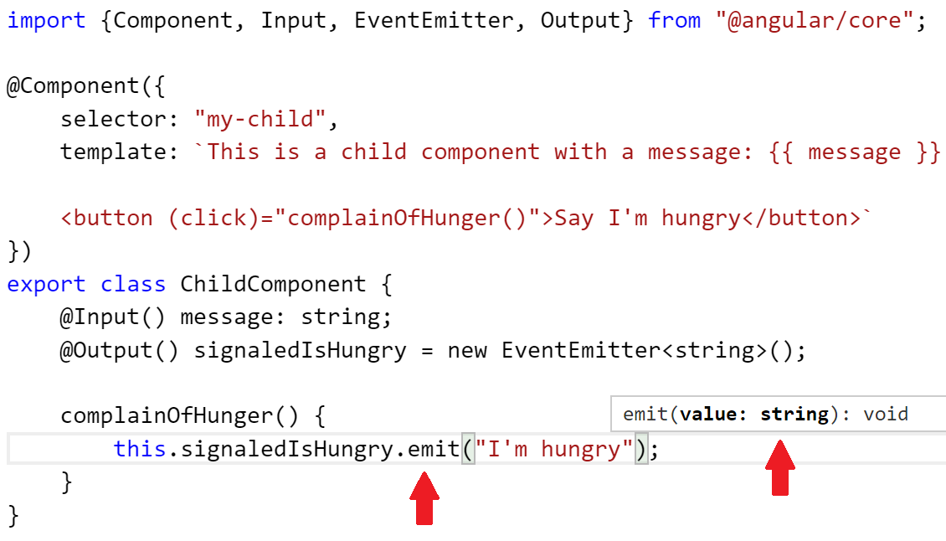
Emit your event

Slide 34

Don’t mutate data in child components.

Slide 35

What are Services?
Services are best used to create, read, update and delete data
Enforces separation of concerns
Think of it like this: you don’t want your database in your view!

Slide 36
Services in Angular 1
In Angular 1, we had 5 different kinds of services:
  Provider
  Service
  Factory
  Value
  Constants
In Angular 2, we have 1 kind of service:
  Service
Which do you prefer?

Slide 37
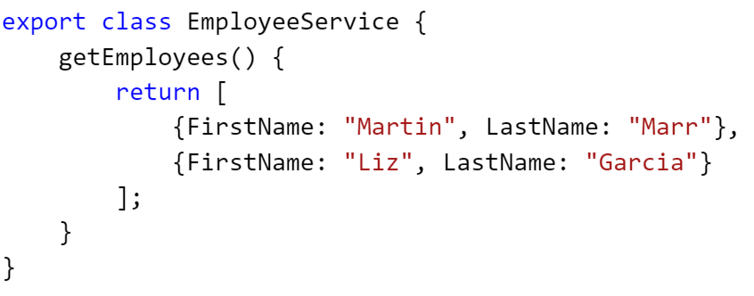
Step 1 – Make class with data

Slide 38
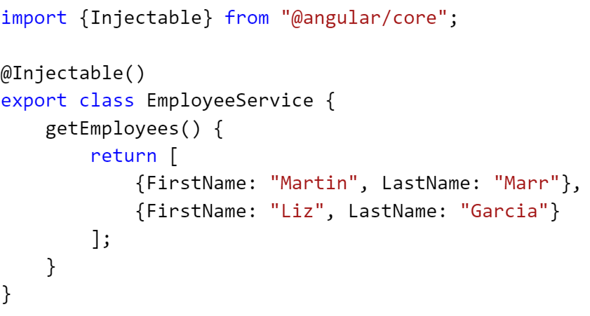
Step 2 – Import @Injectable and decorate

Slide 39
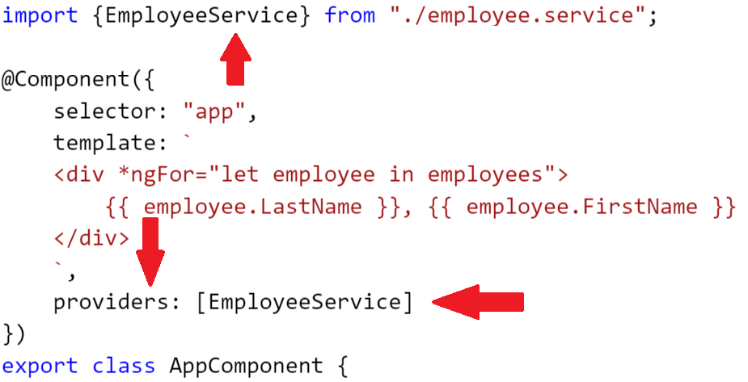
Steps 3 and 4 – Import and register

Slide 40
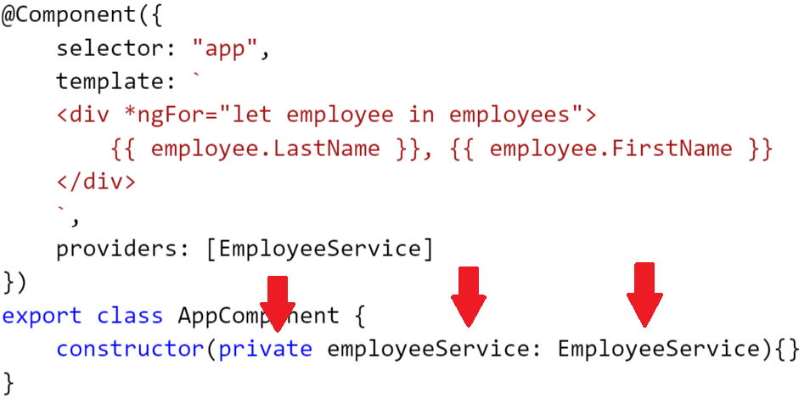
Step 5 – Add as property and to constructor

Slide 41
Services
Components should know who can do something for them, not how to do it.

Slide 42
Things we couldn’t cover
Pipes
Forms
Routing
Http service
RxJS
So much more!

Slide 43

Rahul Srivastava

